Slide 1
Data Structures
Lecture : Sorting and Searching Algorithm

Slide 2
Scope
• Several sorting algorithms, including:
– bubble sort
– selection sort
– insertion sort
– quick sort
– merge sort
Searching, includes:
– linear search
– binary search algorithms
• Complexity of the search and sort algorithms

Slide 3
Sorting
Process to convert the Unordered list to Ordered list.
Index | 0 | 1 | 2 | 3 | 4
Unordered list | 21 | 20 | 27 | 19 | 16
Index | 0 | 1 | 2 | 3 | 4
Ordered list | 16 | 19 | 20 | 21 | 27
Ascending order
Descending order

Slide 4
Bubble Sort
Concept:
  Compare 1st two elements
    If out of order, exchange them to put in order
  Move down one element, compare 2nd and 3rd elements, exchange if necessary. Continue until end of array.
  Pass through array again, exchanging as necessary
  Repeat until pass made with no exchanges.

Slide 5
Step-by-step example
First Pass: ( 5 1 4 2 8 )
( 1 5 4 2 8 ), Swaps since 5 > 1. move on ( 1 4 5 2 8 ), Swap since 5 > 4. move on ( 1 4 2 5 8 ), Swap since 5 > 2. move on ( 1 4 2 5 8 ), does not swap. End of pass#1
2nd Pass: ( 1 4 2 5 8 )
( 1 4 2 5 8 ) does not swap. move on
( 1 2 4 5 8 ), Swap since 4 > 2. move on ( 1 2 4 5 8 ) does not swap. move on
( 1 2 4 5 8 ) does not swap. End of pass#2
kalpoma@gmail.com

Slide 6
Now, the array is already sorted, but the algorithm does not know if it is completed. The algorithm needs one whole pass without any swap to know it is sorted.
Third Pass: ( 1 2 4 5 8 )
( 1 2 4 5 8 )
( 1 2 4 5 8 )
( 1 2 4 5 8 ) Terminate.

Slide 7
Bubble Sort Function
/* Bubble sort for integers */
void SWAP(a,b) { int t; t=a; a=b; b=t; }
void bubble( int a[], int n ) {
int pass, i;
for(pass=1;pass<n;pass++) { // n-1 passes thru the array.
for(i=0;i<(n-1);i++)// From start to the end of unsorted part
{ // If adjacent items out of order, swap
if( a[i]>a[i+1] )
SWAP(a[i],a[i+1]);
}
}
}
This code will not be able to terminate the bubble sort operation on the third pass. Need to modify the algorithm.

Slide 8
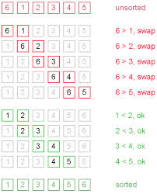
Example 2:

Slide 9
Bubble SortFunction (re-define)
void SWAP(a,b) { int t; t=a; a=b; b=t; }
void bubble( int a[], int n ) {
int pass, j, flag;
for(pass=1;pass<n;pass++) {//break if no swap
flag = 0;
for(j=1;j<(n-pass);j++) { //discard the last
if( a[j]>a[j-1] ) {
SWAP(a[j-1],a[j]); flag = 1;}
}
if (flag==0) break;
}
}

Slide 10
Bubble Sort - Tradeoffs
Benefit:
  Easy to understand and implement
Disadvantage:
  Inefficient: slow for large arrays
1-<number>

Slide 11
Selection Sort
Concept for sort in ascending order:
  Locate smallest element in array. Exchange it with element in position 0
  Locate next smallest element in array. Exchange it with element in position 1.
  Continue until all elements are arranged in order
1-<number>

Slide 12
Selection Sort - Example
Array numlist contains:
Smallest element is 2. Exchange 2 with element in 1st position in array:
11 | 2 | 29 | 3
2 | 11 | 29 | 3

Slide 13
Example (Continued)
Next smallest element is 3. Exchange 3 with element in 2nd position in array:
Next smallest element is 11. Exchange 11 with element in 3rd position in array:
2 | 3 | 29 | 11
2 | 3 | 11 | 29

Slide 14
For 4 elements:
  How many positions were selected?
  How many selection will be needed for n number of elements?

Slide 15
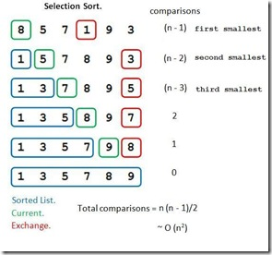
Min value | Min Index
8 | 0
5 | 1
1 | 3
5 | 1
3 | 5
7 | 2
5 | 5
8 | 3
7 | 5
9 | 4
8 | 5

Slide 16
A Selection Sort Function:
void selectionSort(int array[], int n)
{
int select, minIndex, minValue;
for (select = 0; select < (n - 1); select++)
{ //select the location and find the minimum value
minIndex = select;
minValue = array[select];
for(int i = select + 1; i < n; i++)
{ //start from the next of selected one to find minimum
if (array[i] < minValue)
{
minValue = array[i];
minIndex = i;
}
}
array[minIndex] = array[select];
array[select] = minValue;
}
}

Slide 17
Selection Sort - Tradeoffs
Benefit:
  More efficient than Bubble Sort, since fewer exchanges
Disadvantage:
  May not be as easy as Bubble Sort to understand
1-<number>

Slide 18
Insertion Sort
Mark first element as sorted,
Next for each unsorted element
'extract' the element
for i = last Sorted Index to 0
if current SortedElement > extracted Element
move/shift sorted element to the right by 1
else: insert extracted element

Slide 19
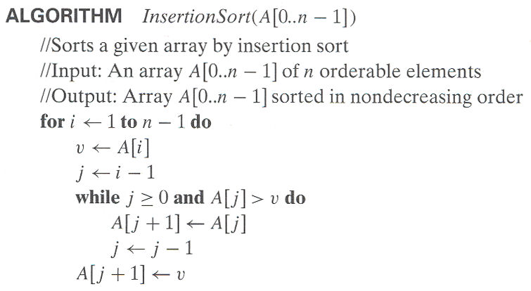
Pseudocode of Insertion Sort

Slide 20
Insertion Sort
To sort array A[0..n-1], sort A[0..n-2] recursively and then insert A[n-1] in its proper place among the sorted A[0..n-2]
Usually implemented bottom up (non-recursively)
Example: 6, 4, 1, 8, 5
6 | 4 1 8 5
4 6 | 1 8 5
1 4 6 | 8 5
1 4 6 8 | 5
1 4 5 6 8
0 1 2 3 4

Slide 21
Example: The following table shows the steps for sorting the sequence {3, 7, 4, 9, 5, 2, 6, 1}. In each step, the item under consideration is underlined. The item that was moved (or left in place because it was biggest yet considered) in the previous step is shown in bold.
3 7 4 9 5 2 6 1
3 7 4 9 5 2 6 1
3 4 7 9 5 2 6 1
3 4 7 9 5 2 6 1
3 4 5 7 9 2 6 1
2 3 4 5 7 9 6 1
2 3 4 5 6 7 9 1
1 2 3 4 5 6 7 9

Slide 22
Merge Sort
Divide: Divide the n element array to be sorted in two sub array of n/2 element each.
Conquer: Sort the two sub array recursively using merge sort
Combine: Merge the two sorted sub array to produce the sorted array

Slide 23
Merge Sort
split each element into partitions of size 1
recursively merge adjancent partitions
for i = leftPartStartIndex to rightPartLastIndex
if leftPartHeadValue <= rightPartHeadValue
copy leftPartHeadValue
else: copy rightPartHeadValue
copy elements back to original array

Slide 24
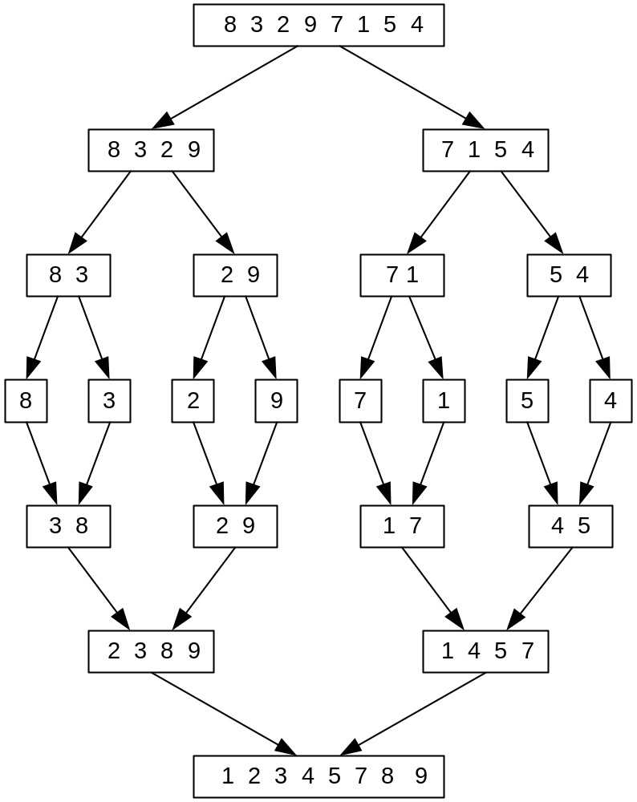
Mergesort Example
Array A
Array B
Array C
Notes:
Go over this example in detail, then do another example of merging, something like:
(1 2 5 7 9)
(3 4 6)

Slide 25
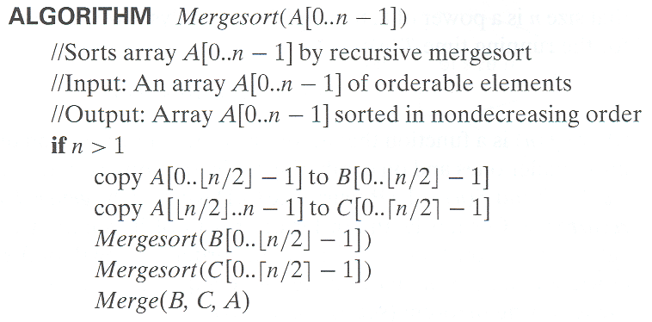
Pseudocode of Mergesort

Slide 26
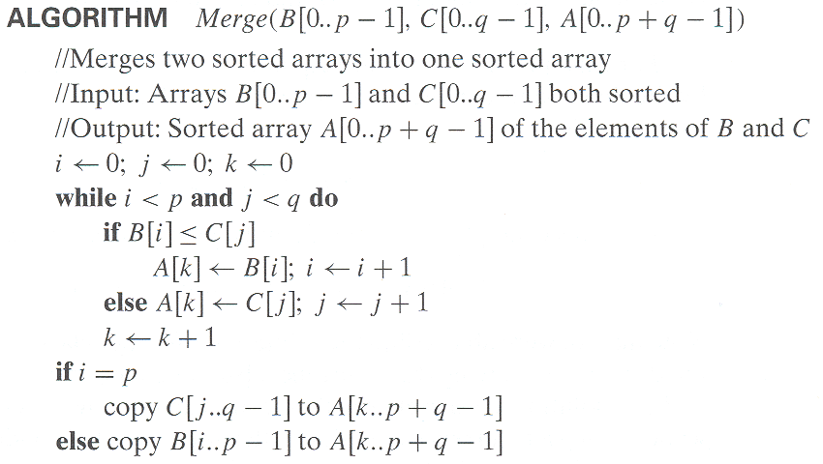
Pseudocode of Merge

Slide 27
Introduction to Search Algorithms
Search: locate/find an item in a list of information
Two algorithms we will examine:
  Linear/Sequential search
  Binary search
Alternate ref: Schaum’s Outline Series:
Theory and Problems of Data Structures by Seymour Lipschutz

Slide 28
Linear Search
Starting at the first element
this algorithm steps sequentially through an array
examine each element until it locates the value it is searching for.

Slide 29
Linear Search - Example
Array numlist contains:
Searching for the the value 11
linear search examines 17, 23, 5, and 11 then stop with getting 11 at index 3 in the list.
Searching for the the value 7
linear search examines 17, 23, 5, 11, 2, 29, and 3 then stop without getting 7 in the list.
17 | 23 | 5 | 11 | 2 | 29 | 3

Slide 30
Linear Search
Algorithm:
  Start search operation for 0 index to last index
  Compare the item to the first element of array
  If item is equal to the array element stop search and send the found message with the index.
  If item is not found continue the comparison with the next element by increasing the index by 1 until the last element.

Slide 31
A Linear Search Function
int searchList(int list[], int numElems, int value)
{
int index = 0; // Used as a subscript to search array
int position = -1; // To record position of search value
bool found = false; // Flag to indicate if value was found
while (index < numElems && !found)
{
if (list[index] == value) // If the value is found
{
found = true; // Set the flag
position = index; // Record the value's subscript
}
index++; // Go to the next element
}
return position; // Return the position, or -1
}

Slide 32
Linear Search - Tradeoffs
Benefits:
  Easy algorithm to understand
  Array can be in any order
Disadvantages:
  Inefficient (slow): for array of N elements, examines N/2 elements on average for value in array, N elements for value not in array
1-<number>

Slide 33
Binary Search
Requires array elements to be in order (sorted)
Divides the array into three sections:
  middle element
  elements on one side of the middle element
  elements on the other side of the middle element
If the middle element is the correct value, done. Otherwise, go to step 1. using only the half of the array that may contain the correct value.
Continue steps 1. and 2. until either the value is found or there are no more elements to examine

Slide 34
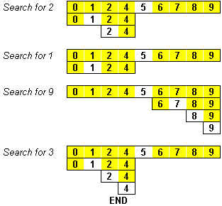
Binary Search - Example

Slide 35
Binary Search
Set first index = 0.
Set last index = the last subscript in the array.
Set found = false.
Set position = -1.
While found is not true and first is less than or equal to last
Set middle to the subscript half-way between array[first] and array[last].
If array[middle] equals the desired value
Set found to true.
Set position to middle.
Else If array[middle] is greater than the desired value
Set last to middle - 1.
Else
Set first to middle + 1.
End If.
End While.
Return position.

Slide 36
A Binary Search Function
int binarySearch(int array[], int n, int value)
{
int first = 0, // First array element
last = n - 1, // Last array element
middle, // Mid point of search
position = -1; // Position of search value
bool found = false; // Flag
while (!found && first <= last)
{
middle = (first + last) / 2; // Calculate mid point
if (array[middle] == value) // If value is found at mid
{
found = true;
position = middle;
}
else if (array[middle] > value) // If value is in lower half
last = middle - 1;
else
first = middle + 1; // If value is in upper half
}
return position;
}

Slide 37
Binary Search - Tradeoffsç
Benefits:
  Much more efficient than linear search. For array of N elements, performs at most log₂N comparisons
Disadvantages:
  Requires that array elements be sorted
1-<number>

Slide 38
Ref. link
http://visualgo.net/
http://www.comp.nus.edu.sg/~stevenha/visualization/index.html
http://en.wikipedia.org/wiki/Bubble_sort#mediaviewer/File:Bubble-sort-example-300px.gif
https://www.youtube.com/watch?v=JP5KkzdUEYI
http://en.wikipedia.org/wiki/Selection_sort#mediaviewer/File:Selection-Sort-Animation.gif

